Slide 1
Unit – II Integration testing

Slide 2
What is Integration Testing?
Terminology
Different Types of Integration Testing:
Big Bang Testing
Top-down Testing
Bottom-up Testing
Performance vs. Load vs. Stress Testing
Sandwich Testing

Slide 3
Definition of Integration Testing
Integration testing ("I&T") is the phase in software testing in which individual software modules are combined and tested as a group.
It occurs after unit testing and before system testing.
Integration testing takes as its input modules that have been unit tested, groups them in larger aggregates, applies tests defined in an integration test plan to those aggregates, and delivers as its output the integrated system ready for system testing.

Slide 4

Why Do You Need Integration Testing?
To make sure that your components satisfy the following requirements:
Functional.
Performance.
Reliability.

Slide 5

Terminology (1)
Stub – the dummy modules that simulates the low level modules.
Driver – the dummy modules that simulate the high level modules.
Top-down approach (also known as step-wise design) - the breaking down of a system to gain insight into its compositional sub-systems.
A bottom-up approach is the piecing together of systems to give rise to grander systems, thus making the original systems sub-systems of the emergent system.

Slide 6
Terminology (2)
Bottleneck – a phenomenon where the performance or capacity of an entire system is limited by a single or limited number of components or resources.
Regression testing - any type of software testing that seeks to uncover new errors, or regressions, in existing functionality after changes have been made to the software, such as functional enhancements, patches or configuration changes.

Slide 7

What Is Big Bang Testing?
In Big Bang Integration testing, individual modules of the programs are not integrated until every thing is ready. It is called 'Run it and see' approach.
In this approach, the program is integrated without any formal integration testing, and then run to ensures that all the components are working properly.

Slide 8

Disadvantages of Big Bang
Defects present at the interfaces of components are identified at very late stage.
It is very difficult to isolate the defects found, as it is very difficult to tell whether defect is in component or interface.
There is high probability of missing some critical defects which might surfaced in production.
It is very difficult to make sure that all the cases for integration testing are covered.

Slide 9

Big Bang Testing: Conclusion
This is not the way you should integrate and test software!
But it might be good with this assumption applied:
for small systems, but not for enterprise level applications.

Slide 10
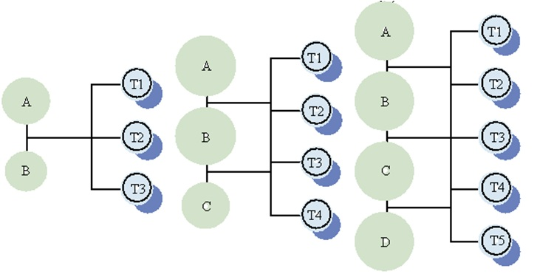
How To Integrate?
If Big Bang integration is bad, then how to integrate?
The answer: incremental integration.

Slide 11
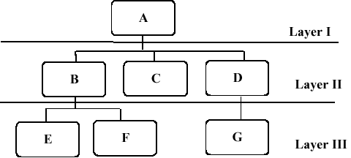
Bottom-up Integration Testing (1)
In bottom up integration testing, module at the lowest level are developed first and other modules which go towards the 'main' program are integrated and tested one at a time.
Bottom up integration also uses test drivers to drive and pass appropriate data to the lower level modules.

Slide 12

Bottom-up Integration Testing (2)
As and when code for other module gets ready, these drivers are replaced with the actual module.
In this approach, lower level modules are tested extensively thus make sure that highest used module is tested properly.

Slide 13
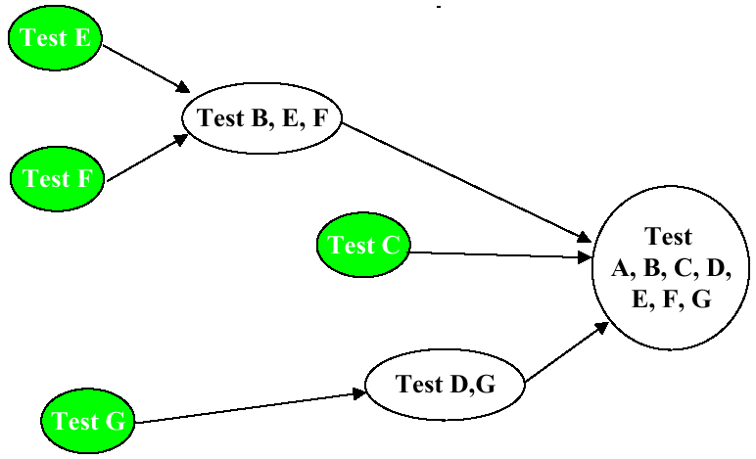
Bottom-up Testing Graphical Represenation

Slide 14
Comments on Graphical Representation
Modules E and F are tested. Then modules B, E, F are tested.
Module F is tested. Then modules F and G are tested.
Module C is tested.
Finally – modules A, B, C, D, E, F, G are tested.

Slide 15
Advantages of Bottom-up Testing
Behavior of the interaction points are crystal clear, as components are added in the controlled manner and tested repetitively.
Appropriate for applications where bottom up design methodology is used.

Slide 16
Disadvantages of Bottom-up Testing
Writing and maintaining test drivers is more difficult than writing stubs.
This approach is not suitable for the software development using top-down approach.

Slide 17
Top-down Testing
Top down integration testing is an incremental integration testing technique which begins by testing the top level module and progressively adds in lower level module one by one.
Lower level modules are normally simulated by stubs which mimic functionality of lower level modules.
As you add lower level code, you will replace stubs with the actual components.

Slide 18
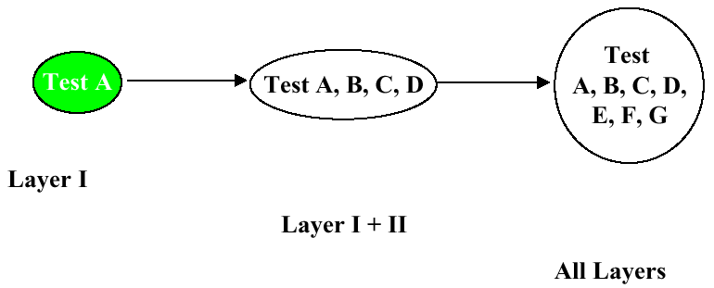
Advantages of Top-down Testing
Driver do not have to be written when top down testing is used.
It provides early working module of the program and so design defects can be found and corrected early.

Slide 19
Disadvantages of Top-down Testing
Stubs have to be written with utmost care as they will simulate setting of output parameters.
It is difficult to have other people or third parties to perform this testing, mostly developers will have to spend time on this.

Slide 20

Top-down And Bottom-up Testing: Conclusion
You’ll probably use a combination of these two techniques.
It’s called Sandwich testing strategy.

Slide 21
Sandwich Testing Strategy
Combines top-down strategy with bottom-up strategy
The system is view as having three layers
A target layer in the middle
A layer above the target
A layer below the target
Testing converges at the target layer
How do you select the target layer if there are more than 3 layers?
Heuristic: Try to minimize the number of stubs and drivers

Slide 22
Graphical Representation of Sandwich Testing Strategy
A
Level I
Test E
B
C
D
Level II
E
F
G
H
Level III
Test B, E, F
Bottom
Level
Tests
Test F
Test
A, B, C, D,
E, F, G, H
Test G
Test D,G,H
Test H
Test A,B,C, D
Top
Level
Tests
Test A

Slide 23
Comments on Graphical Representation
Modules E and F are tested. Then B, E, F are tested.
Modules G and H are tested. Then D, G, H are tested.
Module A is tested. Then A, B, C, D are tested.
Finally – modules A, B, C, D, F, G, H are tested.

Slide 24

Sandwich Testing Strategy: Conclusions
Top and Bottom Layer Tests can be done in parallel.
Does not test the individual subsystems thoroughly before integration.

Slide 25

Performance vs. Load vs. Stress testing
There are three main types of speed-related testing: performance testing, load testing and stress testing.

Slide 26

Performance testing
The goal of performance testing is not to find bugs, but to eliminate bottlenecks and establish a baseline for future regression testing.

Slide 27

Load Testing
Load testing is usually defined as the process of exercising the system under test by feeding it the largest tasks it can operate with.
Load testing is sometimes called volume testing, or longevity/endurance testing.

Slide 28

Examples of Load Testing
Testing a word processor by editing a very large document
Testing a printer by sending it a very large job
Testing a mail server with thousands of users mailboxes
A specific case of volume testing is zero-volume testing, where the system is fed empty tasks

Slide 29

Stress Testing (1)
Testing conducted to evaluate a system or component at or beyond the limits of its specified requirements to determine the load under which it fails and how.
A graceful degradation under load leading to non-catastrophic failure is the desired result.

Slide 30

Stress Testing (2)
Stress testing tries to break the system under test by overwhelming its resources or by taking resources away from it (in which case it is sometimes called negative testing).
The main purpose behind this madness is to make sure that the system fails and recovers gracefully -- this quality is known as recoverability.

Slide 31

Recommendations for Integration Testing
OK, I want to test the software. Any recommendations?

Slide 32

Steps of Integration Testing (1)
Select component to test and unit test the classes of the component.
Put selected component into system. Do any preliminary fix-up necessary to make the integration test operational (drivers, stubs).
Define test cases that exercise all uses cases with the selected component

Slide 33

Steps of Integration Testing (2)
Define test cases that exercise the selected component
Execute performance tests
…and once again with another component…
The primary goal of integration testing is to identify errors in the (current) component configuration.

Slide 34

Main Point: Incremental Integration
All the units of a system must be integrated consecutively and integrated in step by step process by incrementing the levels of testing at one end to other end.

